Slide 1
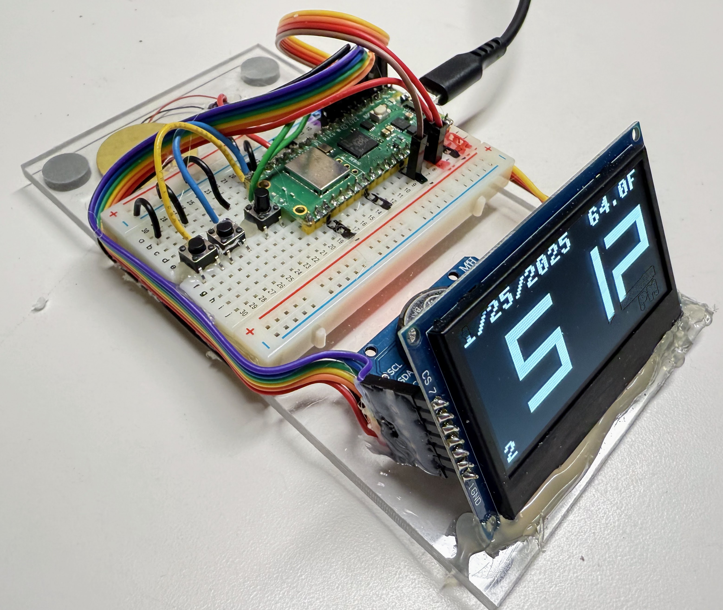
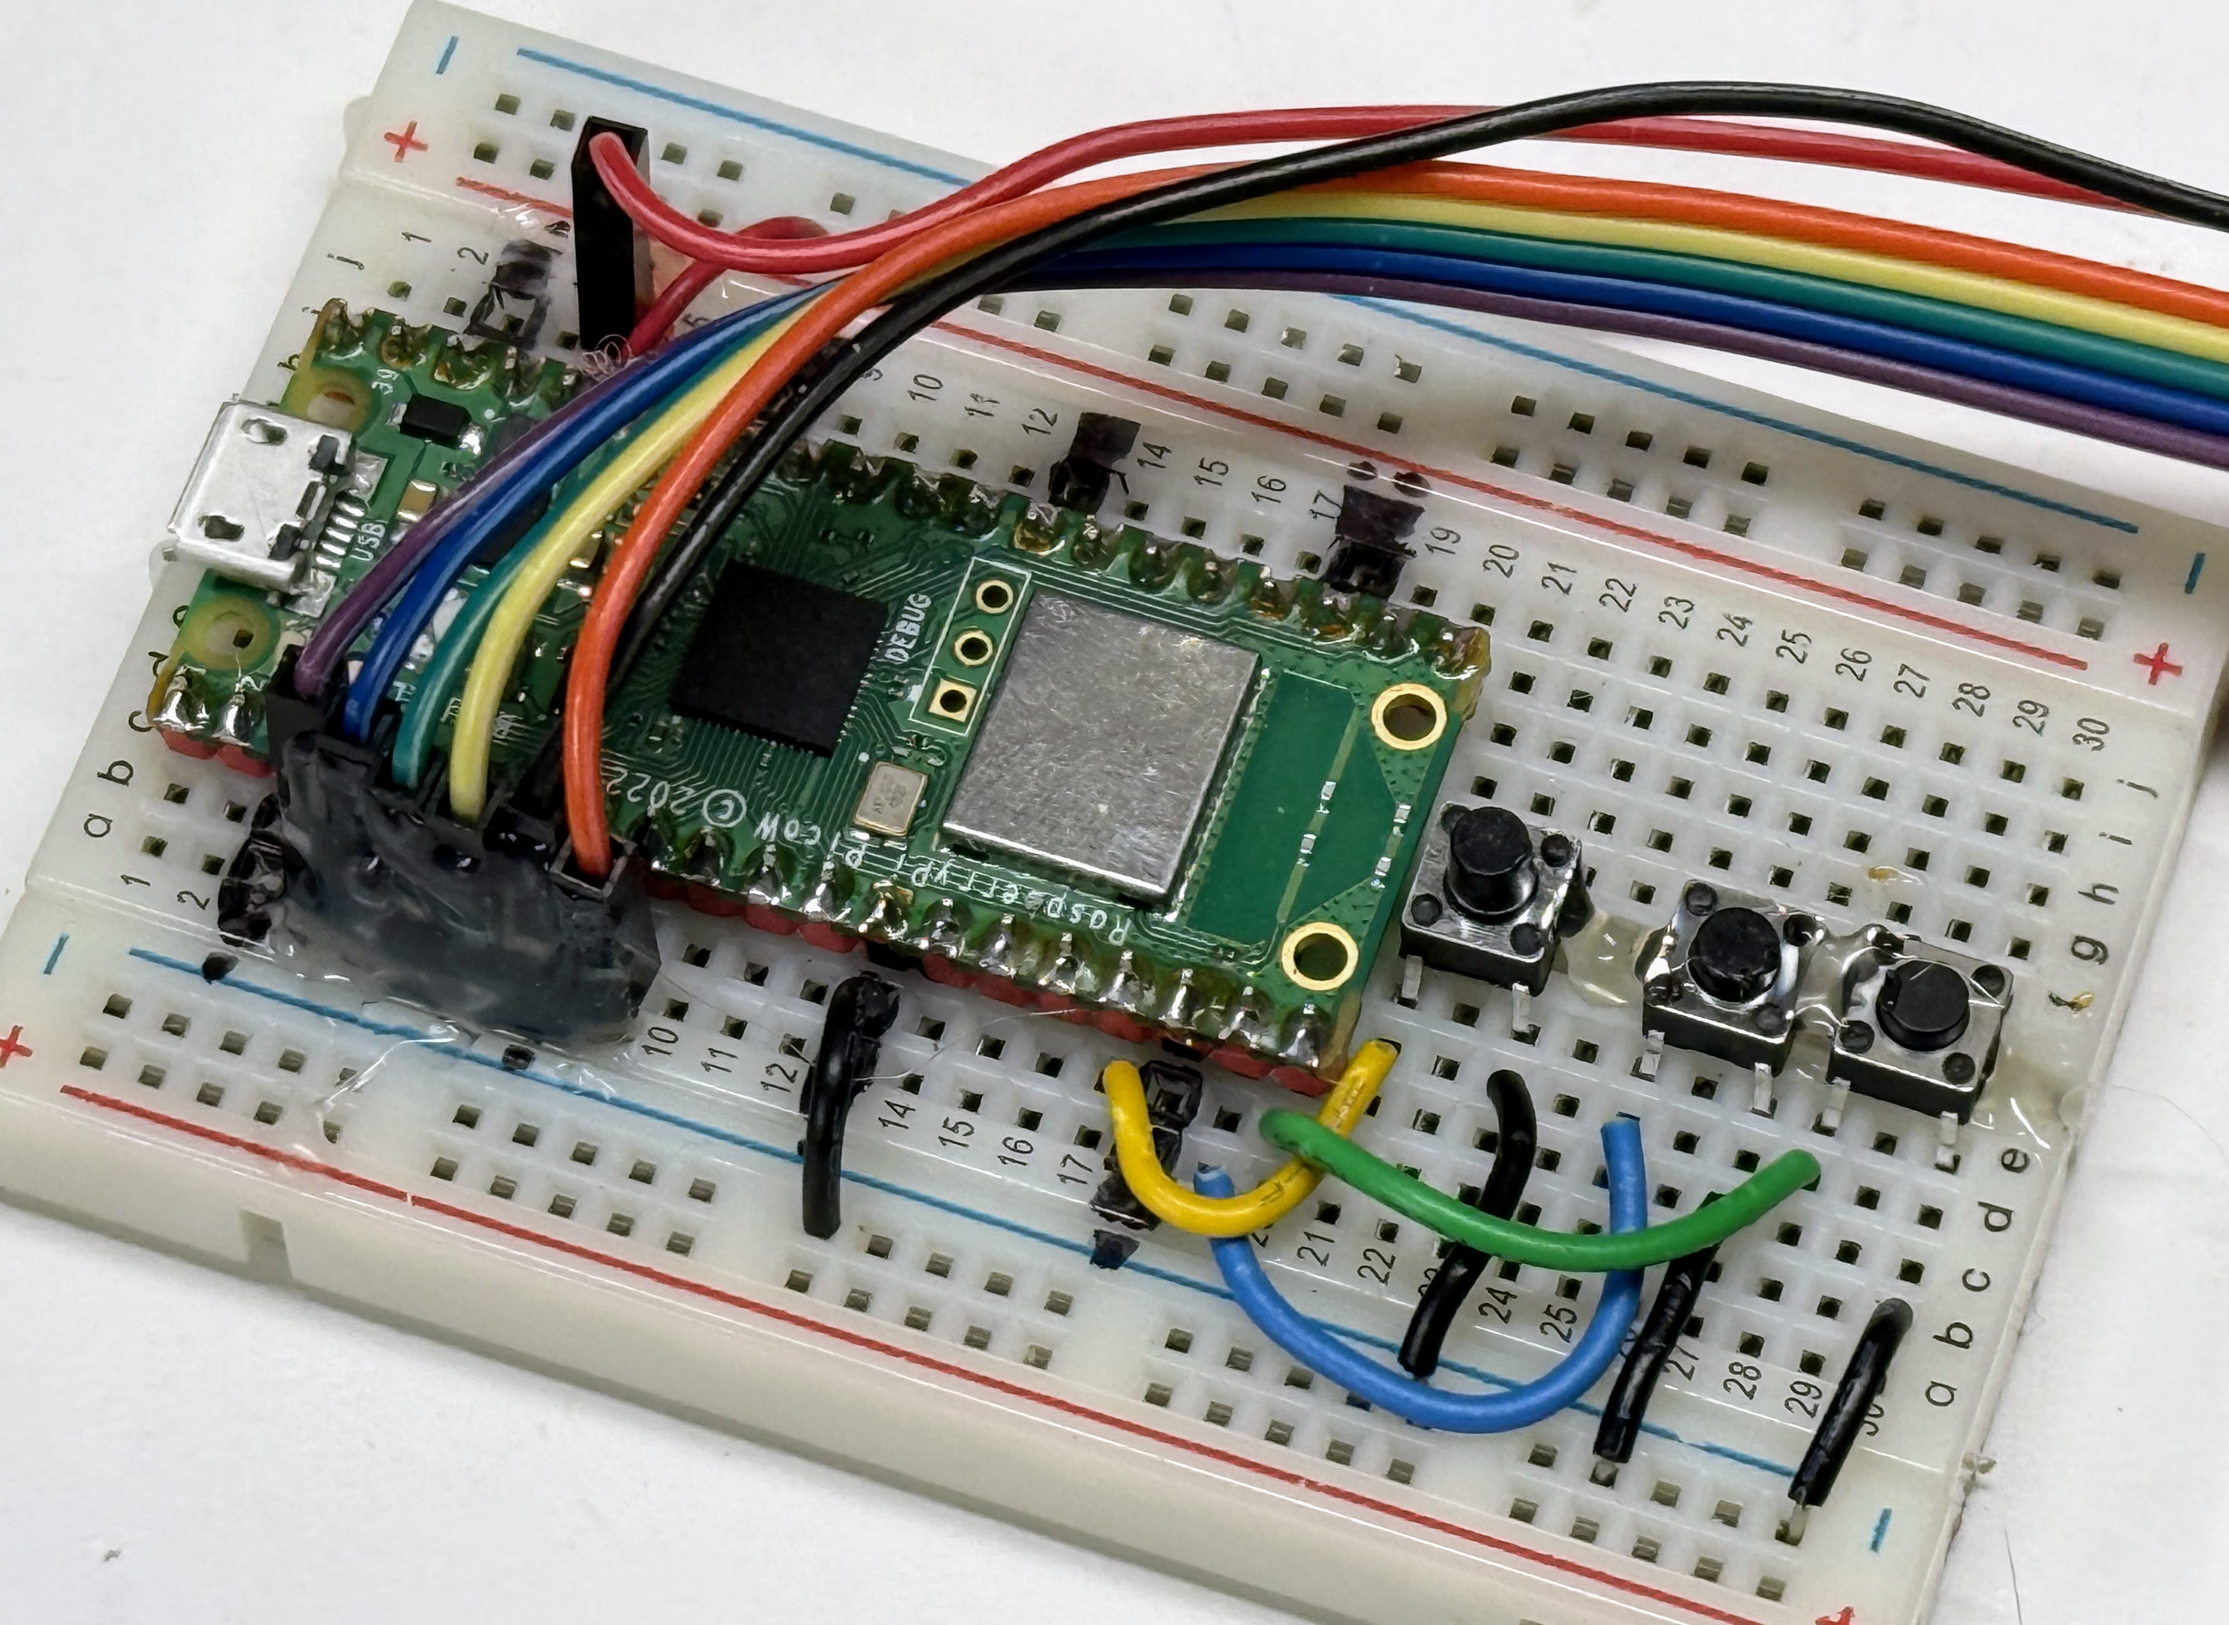

Large OLED Smart Clock Assembly Instructions – version 0.02
Assembly Steps:
Peal protective backing off the plexiglass base
Attache the 4 felt pads to the corners of the base
Peal the backing for the breadboard and place it in the center of the base
Place the red jumper wire on the right row 1 to the red power bus on the right (+5).
Attach the black jumper wire from row 8 on the right to the blue bus GND
Put the Raspberry Pi Pico W into the breadboard making sure that USB connector is at the top of the breadboard and the pins are aligned like the diagram
Place the buttons on the breadboard over the center trough oriented so that the legs of the buttons are on opposite sides of the center trough and closing the switch will close the connection between the rows of the breadboard when pressed.
Attach the 7-wire display cable to the OLED making sure that the black wire is on the GND connection
Attached the display cable to the breadboard in the left side from rows 3 to 9. Make sure that the black wire is on the GND pin (row 8). Make sure that the red wire is attached to right red positive power rail
Place the CR2032 coin cell battery in the real-time clock making sure the positive side is on the top
Attache the 4-wire cable to the real time clock making sure that the black GND and the red VCC are connect to the correct pins
Attach the other of the 4-wire real-time clock cable to the breadboard. Connect yellow to row 1 on the left and orange on row 2 on the left. Connect the red wire to the red power rail on the right and the black wire to the GND on the right
Attache the 3 black ground wires between lower left corner of the buttons to the GND power rail on the left
Attach the 3 yellow, blue and green power wires to the upper left of the buttons to GND
Attach piezo speaker to GND and row 14
(Optional) – use cable ties or twist ties to connect the display and the RTC to the base through the holes
Kit Contents:
Plexiglass base
4 felt pads for the feet
Breadboard
Raspberry Pi Pico W
OLED display
7 wire display cable
Real time clock
CR2032 coin-cell battery
4-wire real-time clock cable
3 momentary push buttons
5 black ground wires
3 button wires (yellow, blue and green)
1 red power jumper
3 cable ties
USB connector
5-volt USB power adapter
Piezo speaker
https://dmccreary.github.io/clocks-and-watches/kits/oled-large/

